Slide 1
Unsupervised Feature Learning via Non-Parametric Instance Discrimination
CVPR2018
胡超杰
2019.4.12

Slide 2
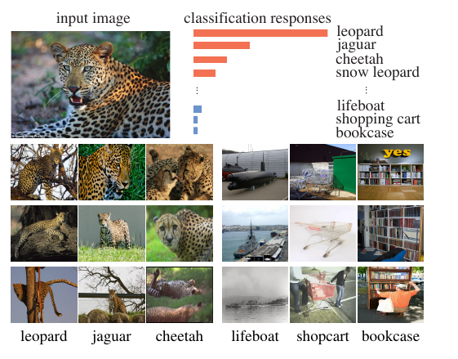
classification
visually correlated

Slide 3
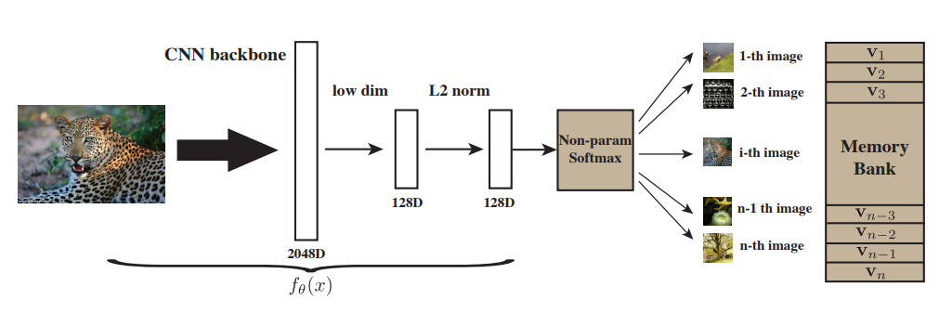

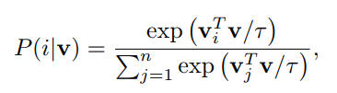
Non-Parametric Softmax Classifier

Slide 4
Noise-Contrastive Estimation
计算量感人
[1] Noise-contrastive estimation: A new estimation principle for unnormalized statistical models(AISTATS 2010)
[2] Notes on Noise Contrastive Estimation and Negative Sampling(arxiv)
[3] https://spaces.ac.cn/archives/5617/comment-page-1

Slide 5


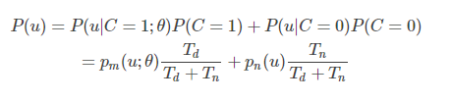

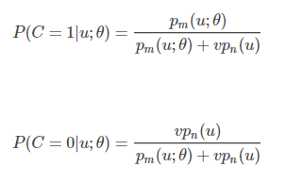

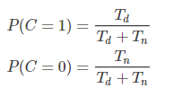
Noise-Contrastive Estimation
真实样本
通过学习一个分类器把这两类样本区别开来，并能从模型中学到数据的属性，噪音对比估计的思想就是“通过比较而学习”。
噪声样本
v是正负样本比例

Slide 6
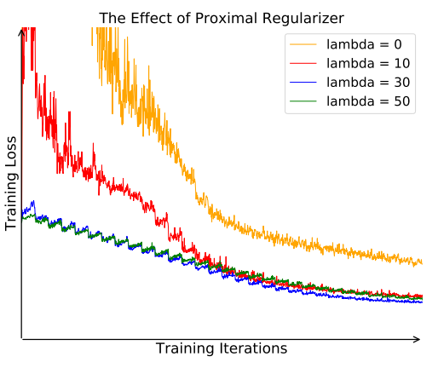

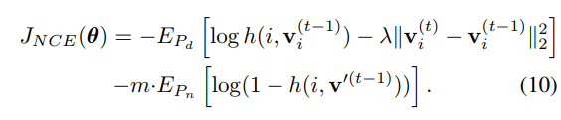
Proximal Regularization

Slide 7
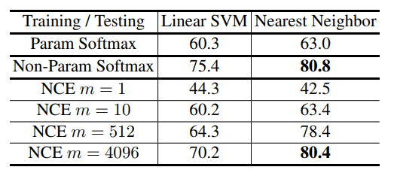
Parametric vs. Non-parametric Softmax
cifar-10
基于学习的特征表示来评估分类有效性

Slide 8
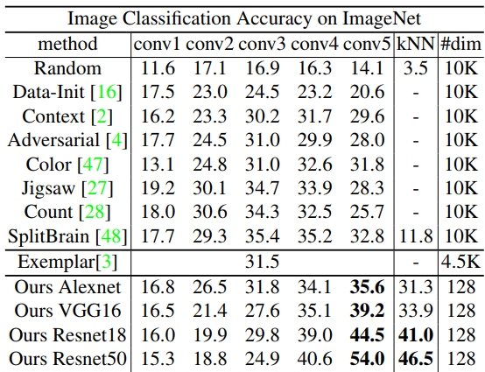
Image Classification

Slide 9
thanks！

